Slide 1
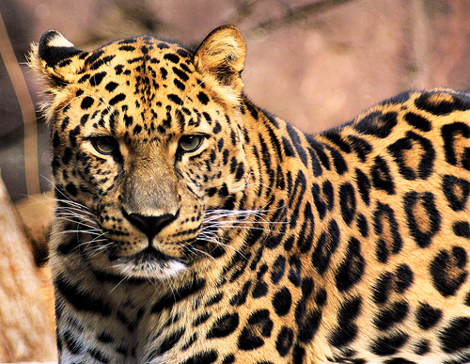
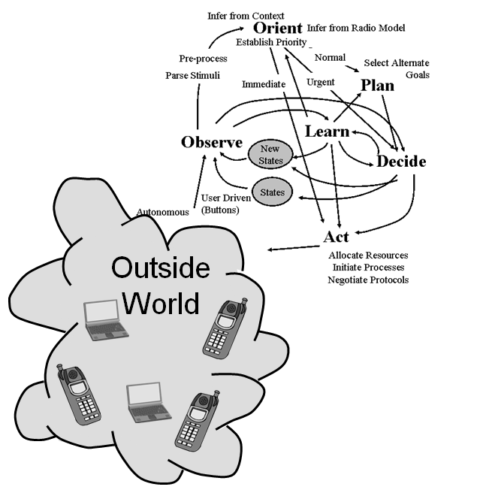
We need to refocus sensing research
DSA was major motivator
  Suboptimal to cooperation with PU for vast majority DSA apps
    Database, CPC, or Coase-like solutions
Signal classification less valuable when a leopard can change its spots
Sensing is important
  Still need radio domain information (time-sensitive)
More value added:
  Assessing another network’s capabilities, estimating their observations, and doing BDA
  Information sharing and organization
  Novel applications
Notes:
CR is applying AI to problems the radio domain

Slide 2
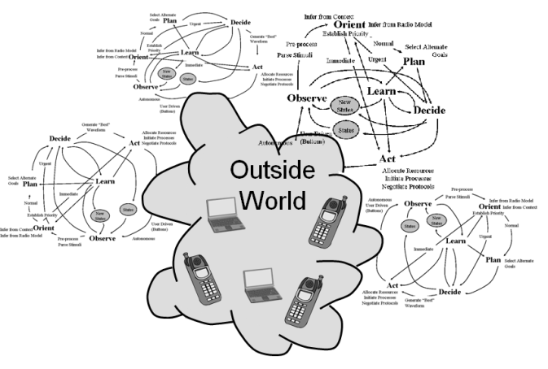
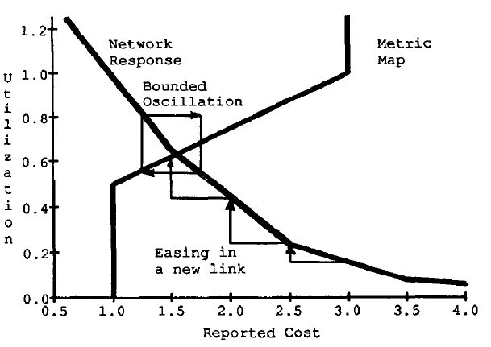
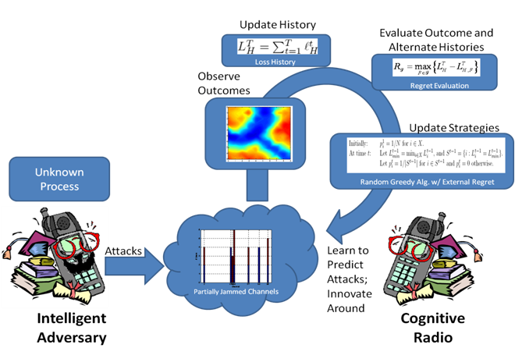
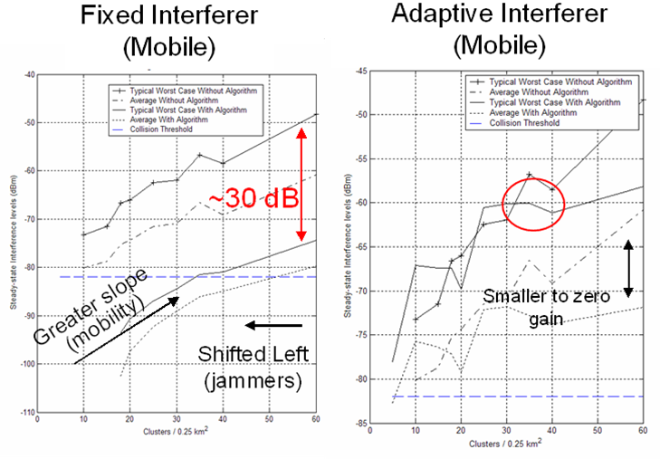
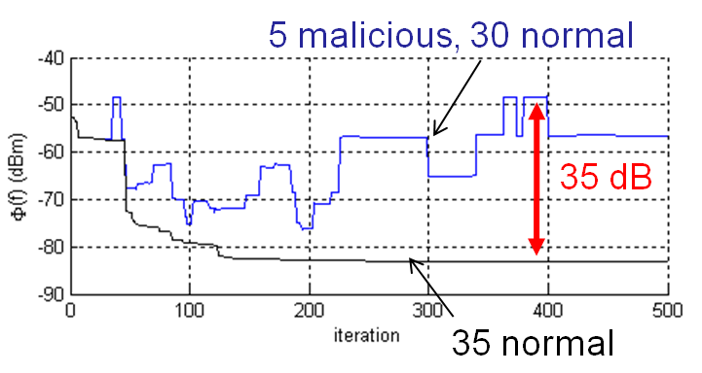
No CR is an Island
(Why Game Theory?)
CR don’t just react,
they interact
  Self coexistence
  Inter-network coexistence
  Instability
And they don’t have to play nice either
  In practice it’s not a 1-on-1 game
Game theory provides analytical structure
  Meta-games?

